Slide 1
Analysis of Banking Operations
By
Utkarsh Sharma

Slide 2
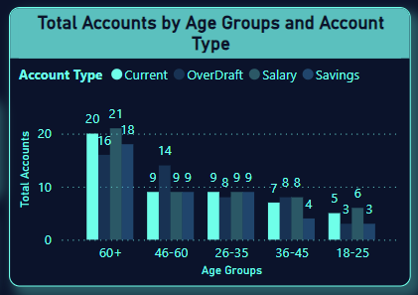
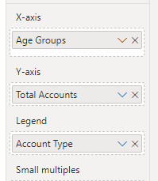
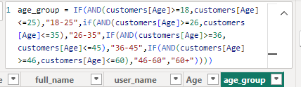
Q1. Hypothesis: Customers of different age groups prefer different types of accounts (e.g., Savings, Current, Salary, Over Draft). Question: What is the distribution of account types across different age groups?
Ans :
Here I have divided age into different age groups, as you can see in chart :
18-25 : Prefer Salary and Current Account
25-35 : This have a uniform preference in all account type.
36-45 : This age group have less preference towards saving account.
46-60 : Preference of this group is more towards Over Draft
60+ : Prefer salary and saving accounts

Slide 3
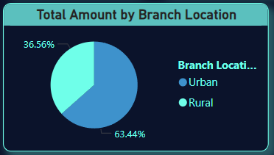
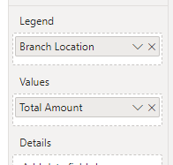
Q2. Hypothesis: Branches located in urban areas have higher total transaction amounts compared to branches in rural areas. Question: What are the total transaction amounts for branches in urban vs. rural areas?
Ans :
This representation clearly shows that the total transaction taken place at Urban branches are more as compared to rural, which means this hypothesis is supported.

Slide 4
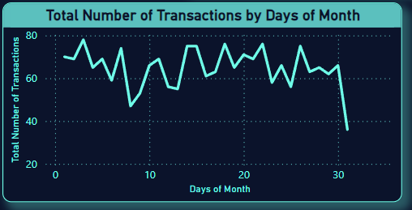
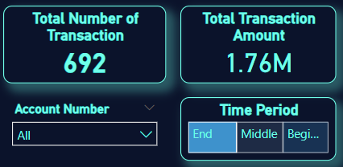
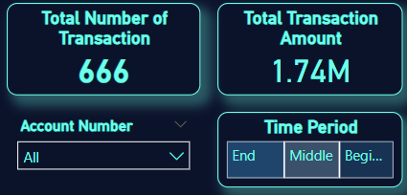
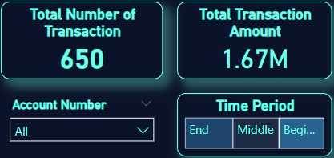
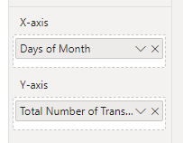
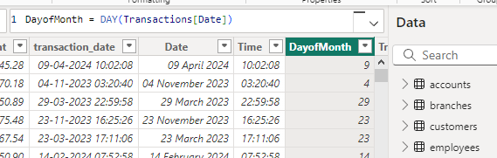
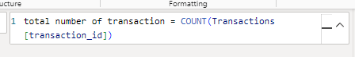
Q3. Hypothesis: There is a significant increase in the number of transactions at the beginning and end of the month. Question: How does the number of transactions vary over a month?
This representation clearly shows number of transaction is more at the ending and middle of month but no. of transaction at beginning is comparatively less so this hypothesis is not supported.
Ans :

Slide 5
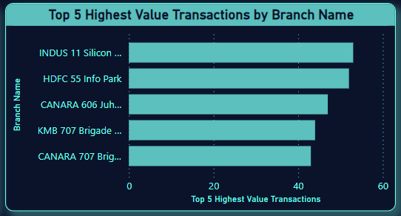
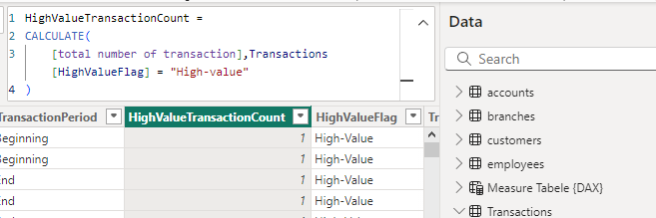
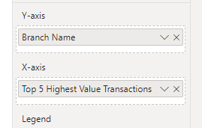
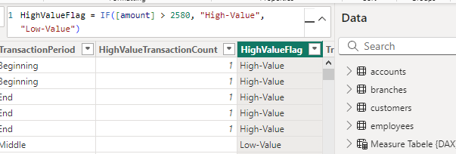
Q4. Hypothesis: High-value transactions (amounts above a certain threshold) are more frequent in certain branches. Question: Which branches have the highest frequency of high-value transactions?
Ans :
In this visualization there are top 5 branches that have highest frequency of high-value transactions
High-value transaction: This KPI is 2580 for our data, i.e. the average transaction amount.

Slide 6
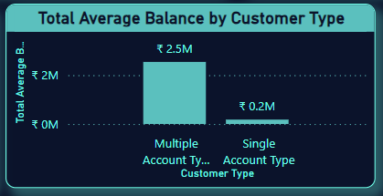
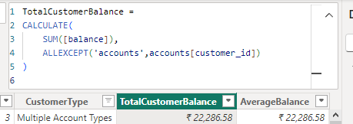
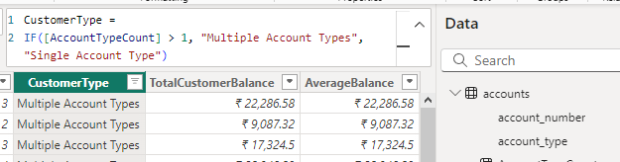
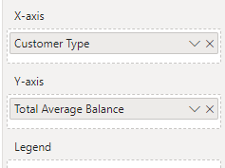
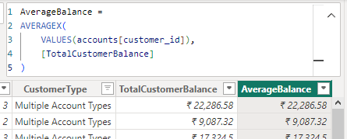
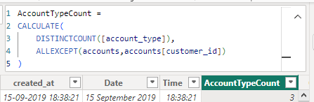
Q5. Hypothesis: Customers with multiple account types have higher overall balances. Question: What is the average balance of customers with multiple account types compared to those with a single account type?
As this visualization clearly giving us an idea that the customers having multiple accounts have higher bank balance as compared to customers having single account, so the given hypothesis is supported.
Ans :

Slide 7
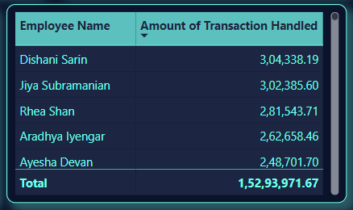
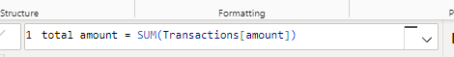
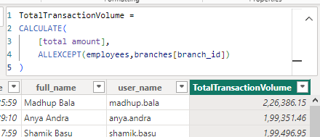
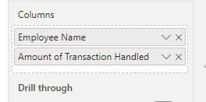
Q6. Hypothesis: Branches with a higher number of employees handle a larger volume of transactions. Question: What is the relationship between the number of employees at a branch and the total transaction volume?
Ans :
This table represents the name of all employee handling the amount of transactions. And when I shortlist the employee with respect to their branches, I observed this hypothesis is true.

Slide 8
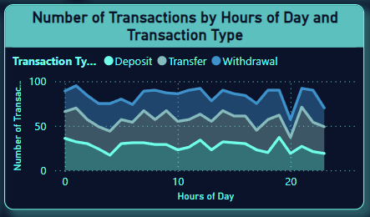

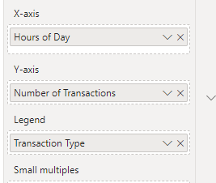
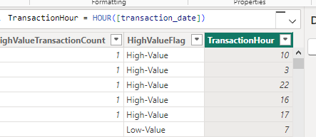
Q7. Hypothesis: Certain types of transactions (e.g., deposits, withdrawals, transfers) are more common at specific times of the day. Question: What are the most common types of transactions, and how do their frequencies vary throughout the day?
Ans :
This representation clearly shows that “Transfers” is most common type of transaction.

Slide 9
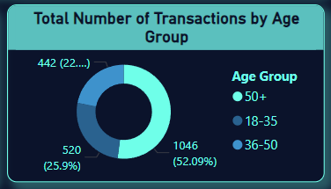
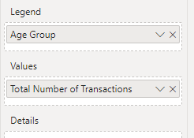
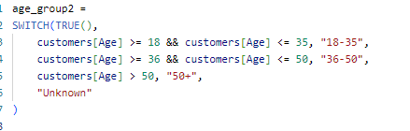
Q8. Hypothesis: Younger customers (age 18-35) perform more transactions compared to older customers. Question: What is the transaction frequency across different age groups?
Ans :
This representation tells us that age group “50+” have higher number of transaction the compared to “18-35” and “36-50”, so this hypothesis is false or not supported.

Slide 10
Dashboard

Slide 11
